Slide 1
Co-production
What it means
&
How we do it

Slide 2
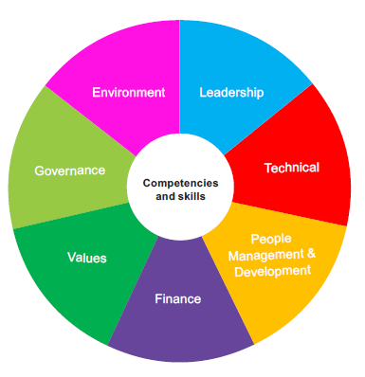
In the Competency Framework, this course sits within the Leadership wheel
Values : living our values each and every day
Finance : be mindful of spending other’s money
Governance : be professional
Environment : ensure that our physical and social environment delivers for all
Leadership : lead self, recognising impact on others and play your part in delivering the strategy
Technical : ensure a person centred approach, understanding the part you play at Millennium and in the sector
People Management : be accountable and work together as a team

Slide 3
Meaning
Jointly working with another or others

Slide 4
In health and social care
The Care Act says:
'Co-production is when you as an individual influence the support and services you receive, or when groups of people get together to influence the way that services are designed, commissioned and delivered'.

Slide 5
Partnership
Professionals working with communities and people who use services are likely to have a stronger focus on the outcomes of the support provided when they are co-producing, and potentially a greater focus on prevention.
The expectation being - improved outcomes for people who use services

Slide 6
Benefits of working in a co-productive way
Power
To listen
Enable
Partner
Include
Experts by experience
Partners
Co design

Slide 7
4 plus 1 person centred thinking tool
What have we done?
What have we learnt from that?
What are we pleased about?
What could we have done differently?
The answers to these questions lead to the ‘plus 1′ question –
based on what we know, what should we do next?
Notes:
http://helensandersonassociates.co.uk/person-centred-practice/person-centred-thinking-tools/4-plus-1-questions/

Slide 8
How co-production can help
When working in a co-productive way, there is respect for the assets (ie: knowledge, experience, character) that everyone brings to the process and an emphasis on all the outcomes that people value, rather than just those—such as clinical outcomes—that the organisation values.

Slide 9
Co-production can be broken down into:
co-design, including planning of services
co-decision making in the allocation of resources
co-delivery of services, including the role of volunteers in providing the service
co-evaluation of the service

Slide 10
However, there are some key features that are present in co-production initiatives.
Co-production
define people who use services as assets with skills
break down the barriers between people who use services and professionals
build on people’s existing capabilities
include reciprocity (where people get something back for having done something for others) and mutuality (people working together to achieve their shared interests)
work with peer and personal support networks alongside professional networks
facilitate services by helping organisations to become agents for change rather than just being service providers.
There is no single formula for co-production

Slide 11
Equality
– everyone has assets
Co-production starts from the idea that no one group or person is more important than any other group or person. So everyone is equal and everyone has assets to bring to the process.
Assets
Diversity
It follows from the previous principle that diversity and inclusion are important values in co-production. This can be challenging but it is important that co-production projects are pro-active about diversity
Accessibility
Access needs to be recognised as a fundamental principle of co-production as the process needs to be accessible if everyone is going to take part on an equal basis.
Reciprocity
‘Reciprocity’ is a key concept in co-production. It has been defined as ensuring that people receive something back for putting something in, and building on people’s desire to feel needed and valued. The idea has been linked to ‘mutuality’ and all parties involved having responsibilities and expectations
refer to skills, abilities, time and other qualities that people have

Slide 12
Legal Frameworks
Co-production and the Care Act 2014
Local authorities should, where possible, actively promote participation in providing interventions that are co-produced with individuals, families, friends, carers and the community. ”Co-production” is when an individual influences the support and services received, or when groups of people get together to influence the way that services are designed, commissioned and delivered.
A vision for adult social care 2010
Sets out an approach to social care designed to use the potential of local support networks and build upon the capacity of communities.

Slide 13
Legal Frameworks
The Health and Social Care Act 2012
Includes a number of requirements that relate to co-production and broader ideas around participation/involvement.
in the commissioning of services
through health and wellbeing boards
through Health Watch with local and national organisations to give citizens a greater say in the NHS.
Think Local Act Personal partnership
Co-production in the form of new, collaborative ways of working and new partnerships is a key aspect of personalisation.
Framework for Action
It sets out requirements for engagement:

Slide 14
What are Millennium doing for co-production?

Slide 15
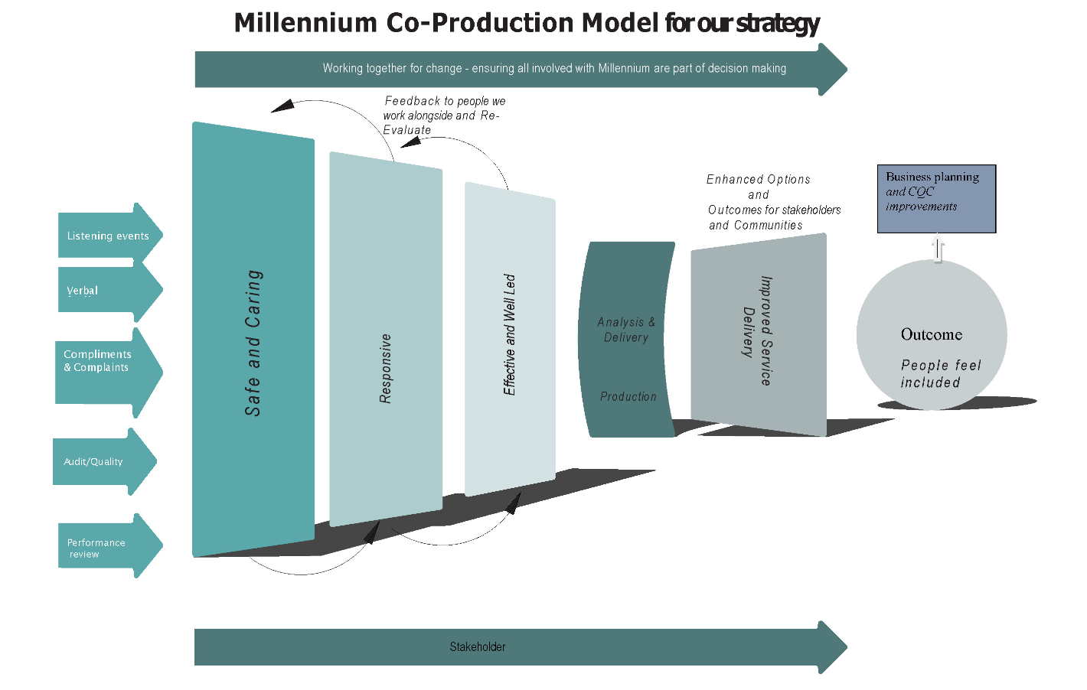
The important aspects below are the arrows coming in signify how we will ensure everyone is part of conception of the design. The way we then transfer this into strategy and delivery is important aspect to ensure that we are working together to achieve this.

Slide 16
We’d like everyone to join and stay on the Millennium co-production bus.
Thank you for taking the time to look at this information session
Millennium

